Slide 1
Fault Tolerant Infective Countermeasure for AES
Secured Embedded
Architecture Laboratory (SEAL)
Sikhar Patranabis and Abhishek Chakraborty
Under the supervision of
Dr. Debdeep Mukhopadhyay

Slide 2
Outline
Introduction
Differential Fault Analysis (DFA)
Countermeasures to DFA – Detection vs Infection
Infective Countermeasures – Formal Proofs of Security
Infective Countermeasures - Loopholes
Fault Tolerant Implementation of Infective Countermeasures
Conclusions

Slide 3
Introduction : Fault Analysis and Countermeasures
Fault Analysis
Adversary injects faults into cryptosystems and analyzes the faulty output to recover the key
Easy to perform, does not require high end equipment
Must design efficient countermeasures against fault attacks
Weakens even mathematically robust cryptosystems

Slide 4
Fault Attacks : A Brief Overview
Introduction of faults in the normal execution of cryptographic algorithms and analysis of faulty output to obtain the key
First conceived in 1996 by Boneh, Demillo and Lipton
E. Biham developed Differential Fault Analysis (DFA) of DES
Today there are numerous examples of fault analysis of block ciphers such as AES under a variety of fault models and fault injection techniques
Popular Fault Injection Techniques – Clock Glitches, Voltage Glitches, EM and Optical Injection Techniques

Slide 5
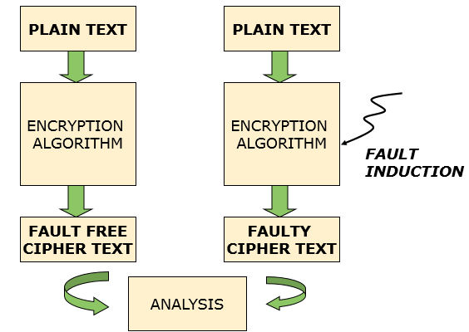
Differential Fault Analysis (DFA)
Comparison of fault-free and faulty ciphertexts
Important factors are fault location and fault model
Fault Location:
Data Path
Key Schedule
Fault Model:
Bit Faults
Byte Faults

Slide 6
DFA of AES: State of the Art
Single fault for unique key recovery, Key Space: 2⁸ , Time Complexity: 2³²
Tunstall, Mukhopadhyay, Ali (WISTP 2011)
2011
2 faults for unique key recovery, Time Complexity: 2³²
Mukhopadhyay (AfricaCrypt 2009)
2009
2003
Demonstrated attack possibility with a single fault
Ali, Mukhopadhyay (eprint 2011) further reduced the time complexity to 2³⁰
Piret et. al. (CHES 2003)
2 faults for unique key recovery, Time Complexity: 2⁴⁰

Slide 7
Countering DFA
Countermeasures to DFA
Detection Based Countermeasures
Vulnerable to attacks on the comparison step
Vulnerable to biased fault attacks
Infection Based Countermeasures
No formal proofs of security
Vulnerable to flow sequence changes

Slide 8
Detection Based Countermeasures
Also known as Concurrent Error Detection (CED) techniques
Use various kinds of redundancy to detect faults
Vulnerable to attacks in the comparison step itself
Vulnerable to biased fault attacks

Slide 9
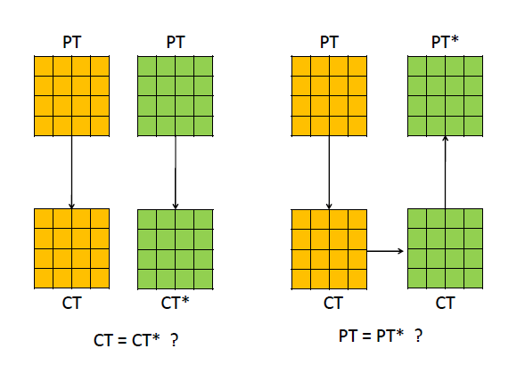
The Basic Principle of CEDs

Slide 10
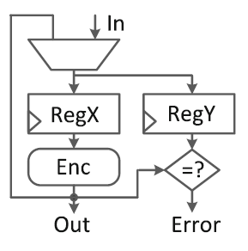
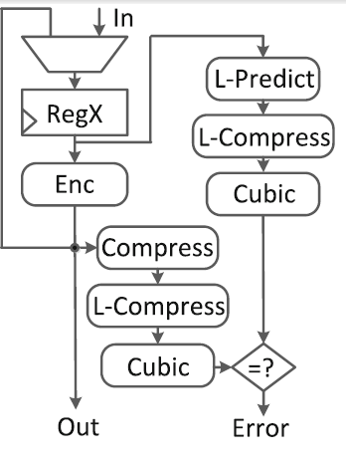
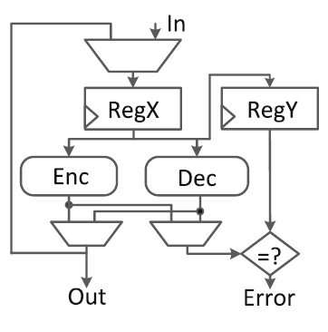
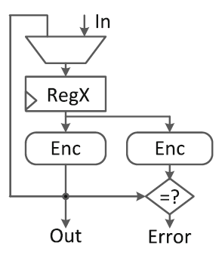
Examples of CED
Time Redundancy
Hybrid Redundancy - REPO
Information Redundancy – Robust Codes
Source : Guo et. al. , Security analysis of concurrent error detection against differential fault analysis – Journal of Cryptographic Engineering, 2014
Hardware Redundancy

Slide 11
Infective Countermeasures
The main initial idea behind infective countermeasures was to diffuse the impact of the fault such that even if the adversary were to attack the comparison step, the state would still be affected

Slide 12
The Infection Mechanism
Source : Lomne et. al. , On the Need of Randomness in Fault attack Countermeasures – Application to AES, FDTC 2012

Slide 13
Infective Countermeasures : State of the Art
Tupsamudre et. al. proposed a randomized infective countermeasure in CHES 2014
Since 2014
Gierlichs et. al. proposed in LatinCrypt 2012 a randomized infective countermeasure that totally does away with explicit consistency checks by clever use of random and dummy rounds
2012-2014
Prior to
2012
Fournier et. al. and Joye et. al. suggested infective countermeasure schemes using deterministic diffusion functions
Proved to be inherently insecure by Lomne et. al. in FDTC 2012
Propagation of faults prevents an attacker from being able to conduct any fault analysis of corrupted ciphertexts
Proved to be insecure by Battistello et. al. in FDTC 2013 and Tupsamudre et. al. in CHES 2014
Addresses several pitfalls of the earlier infective countermeasure scheme
Does not provide any formal proofs of security
Does not consider attacks where the execution order of instructions could be changed
Used consistency checks between cipher and redundant computations

Slide 14
CHES 2014 Infective Countermeasure

Slide 15
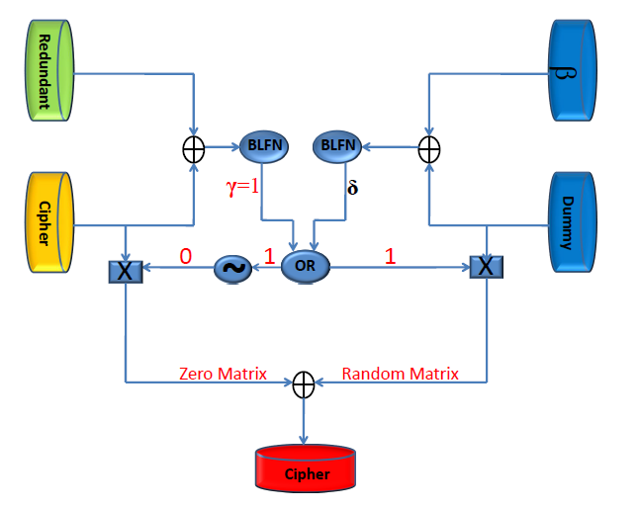
CHES 2014 Countermeasure (Contd.)
Correct Computation
Faulty Computation

Slide 16
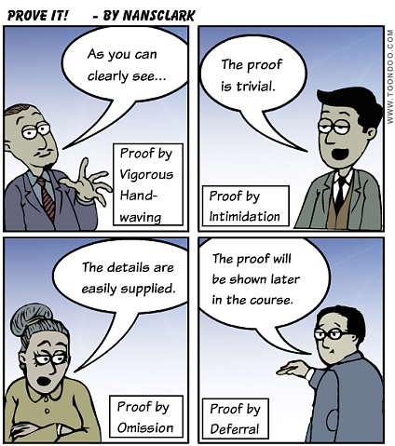
Unexplored Territory-1
Formal Proof of Security
A frequent criticism of infective countermeasures - no explicit formal proof of security

Slide 17
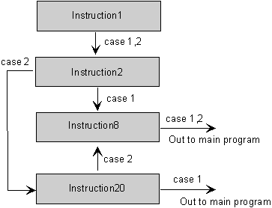
Unexplored Territory-||
The countermeasure provides security against fault attacks that target the state registers
What about faults that target the execution order of instructions instead?
For instance instruction skip attacks

Slide 18
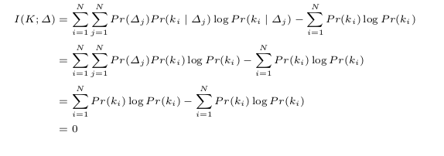
Information Theoretic Proof of Security
Single Fault Injection
Infection upon detection of fault destroys any correlation between output differential ∆ and key K
Hence ∆ and K are independent

Slide 19
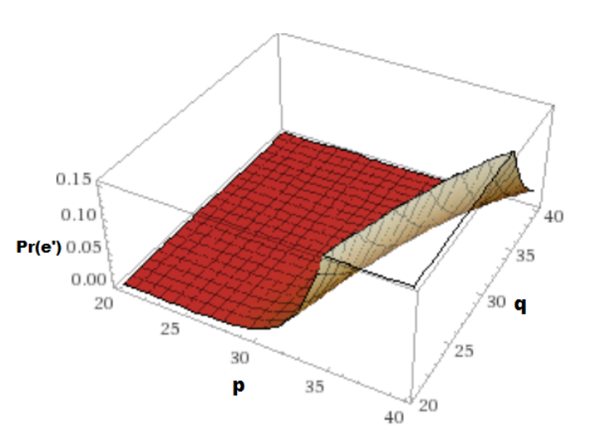
Security Proofs (contd.)
Multiple Fault Injection
The adversary must introduce the same fault in a redundant-cipher round pair
Not easy due to the presence of random intermediate dummy rounds in between
The Attack Probability for 30 Dummy Rounds

Slide 20
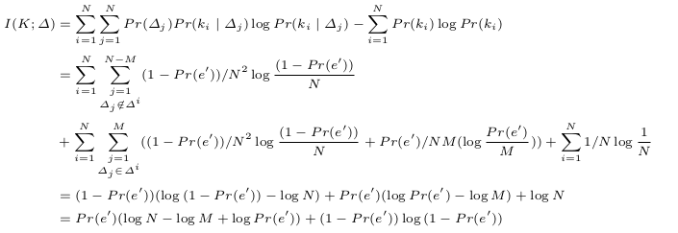
Security Proofs (contd.)
The Evaluation
We focus on the event e’ where an adversary introduces the same fault in a redundant-cipher round pair
Set of faults possible for key $k_{i}$

Slide 21
The Instruction Skip Fault Model
The adversary can skip an instruction
Equivalent to replacing instruction by a NOP
Practically achievable on a variety of architectures
8-bit AVR microcontrollers
32-bit ARM9 processor
32-bit ARM Cortex-M3 processor
Variety of injection techniques possible - Clock glitches, EM Glitches, Voltage glitches and Laser shots

Slide 22
The Attack Idea
What if the adversary skips this step??

Slide 23
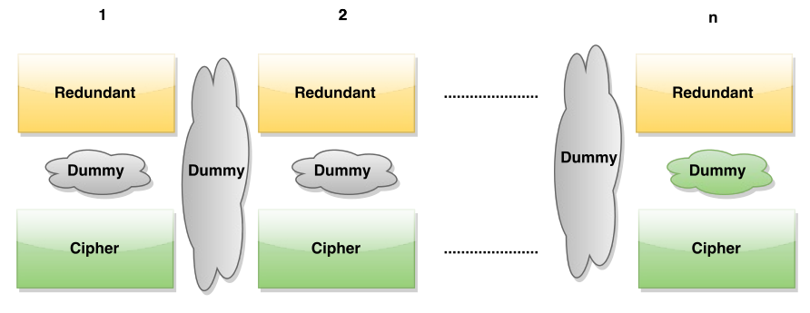
The Attack Procedure
Skip the increment of the round counter after the final redundant round
The last cipher round is replaced by a spurious redundant round
The adversary obtains the output of the 9th round
Replaced by a Redundant Round

Slide 24
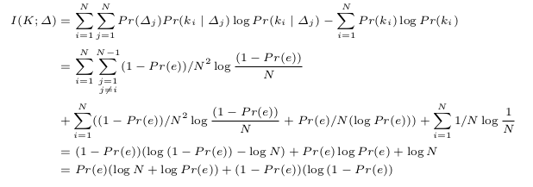
The Information Leakage
Consider the event e that the attacker successfully performs the instruction skip to recover the key

Slide 25
The Loop Holes
Fixed ordering of redundant and cipher rounds
Fault in the redundant round is only detected in the next cipher round
No check if a redundant round being executed is valid
Round counter is not validated

Slide 26
Modified Infective Countermeasure
The relative ordering of cipher and redundant rounds is randomized
The intermediate output after each odd computation round is masked
Penultimate computation could be redundant or cipher
In either scenario, instruction skip gives a masked output that has no correlation with the key

Slide 27
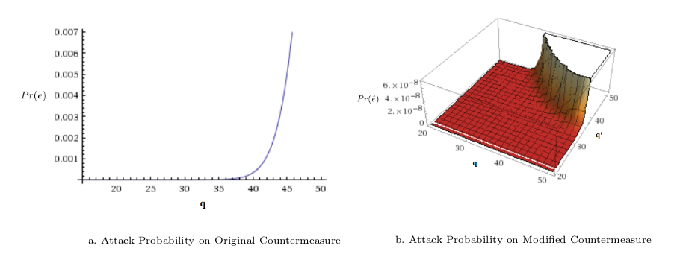
Instruction Skips on the Modified Countermeasure
Must skip two instructions now – the round counter increment as well as the masking steps in two separate rounds
Practically feasible second order fault attack?

Slide 28
Some Comparisons

Slide 29
But what about other Instruction Skip instances ??

Slide 30
Fault Tolerance at the Instruction Level
Injection of faults in two instructions separated by only a few clock cycles is difficult to achieve in practice
Rewrite compiler generated assembly code by replacing each instruction by a sequence of one or more idempotent instructions
All instructions belong to the x86 instruction set and have uniform size of 32 bits
Provides protection against instruction skip attacks in general

Slide 31
Sample Instruction Replacement Sequences

Slide 32
Sample Instruction Replacement Sequences

Slide 33
Impact on Code Size

Slide 34
Simulation Studies

Slide 35
Experimental Set-Up

Slide 36
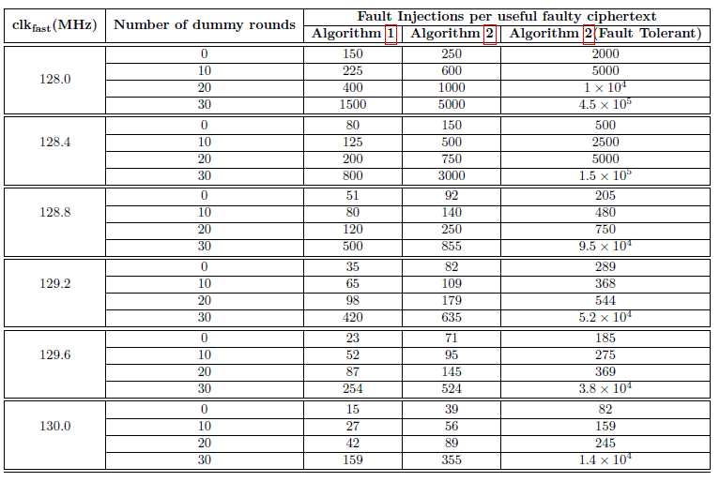
Experimental Results

Slide 37
Conclusions
Infective countermeasures thwart DFA using single and double fault injections that do not alter the flow sequence
Infective countermeasures are vulnerable to instruction skip attacks unless properly implemented
Fault tolerance can be achieved at the instruction level using idempotent instructions

Slide 38
Disseminations
S.Patranabis, A.Chakraborty and D.Mukhopadhyay. Fault Tolerant Infective Countermeasure for AES. In Security, Privacy, and Applied Cryptographic Engineering (SPACE) 2015

Slide 39
Thank You for your attention!!

